Slide 1


Montréal Travelling Guide
Discover Secret Code of Montréal
Huang, Yaowu
Li, Zhiwei
Lyamkin, Andrey

Slide 2
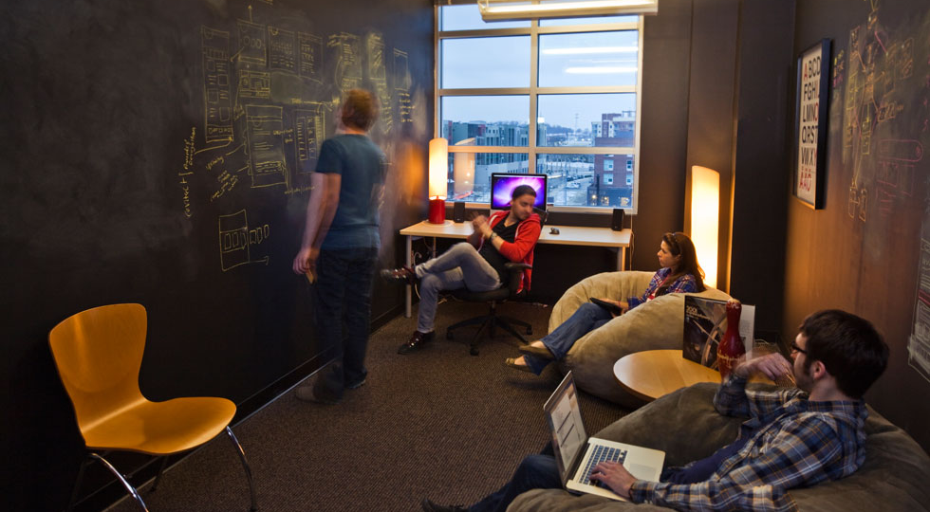
OFFERING:
Tons of novel information contributed by local residences
Easy to find events and local services nearby sightseeing
A virtual Montréal linking tourists, residences and local service providers

Slide 3

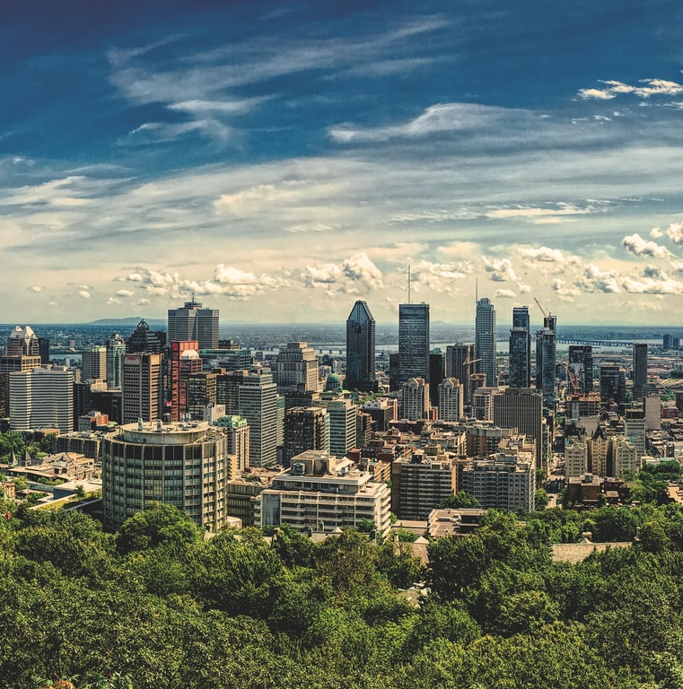
Agenda
Overall Sitemap
Design and Solution
Landing Page
Account Management
Share Attraction
#MontrealOnLine
Partner
Searching Engines
Details
FAQ
Future Works

Slide 4
Overall Sitemap

Slide 5



Slide 6
Design and Solution

Slide 7
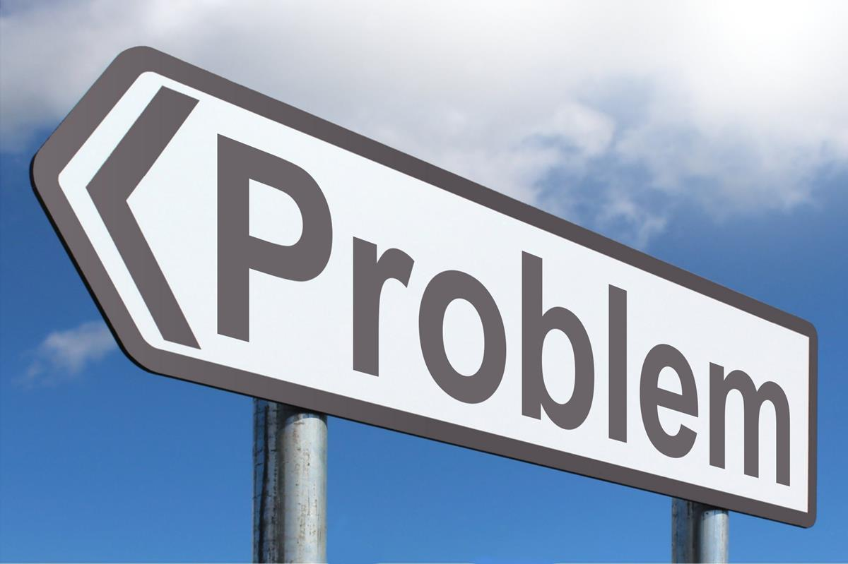
Challenges & solutions – Detail Page
Control images size in a Carousel
Notes:
Self-intro
Eye-catching effect and a nice way to demonstrate multiple picture/text at the same time.
However, when I tried to put it into our project, I encountered one time-consuming problem.

Slide 8
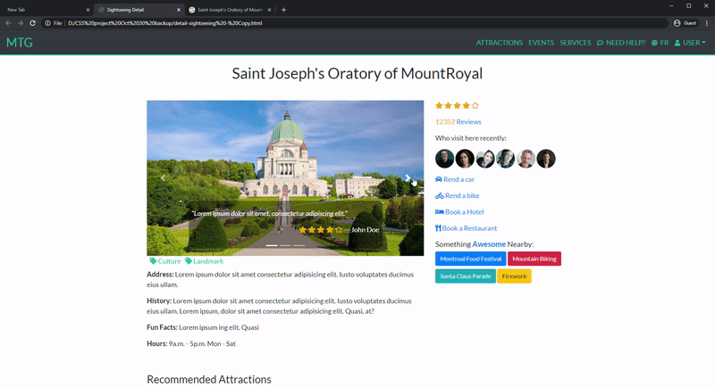
Challenges & solutions – Detail Page
Notes:
Since the images have different size in terms of height, they may change the layout during their transitions, which is not we expected.
Tried to use different boostrap class and css to control their behavior, without jeopardizing the responsive layout. Unfortunately none of the solution can apply to my case.

Slide 9
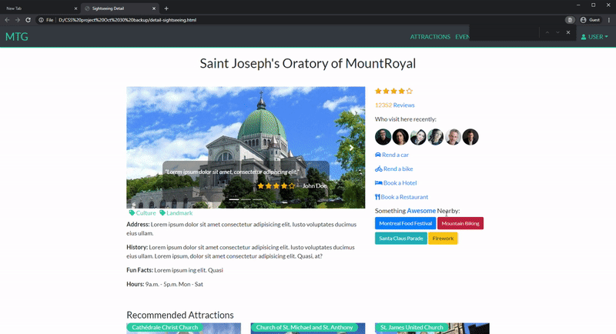
Challenges & solutions – Detail Page
Notes:
Even though I strongly believe there must be a applicable solution out there, we have to pay attention the deadline to deliver the project. So I head back to the option B, use local image and edited them with the same size.

Slide 10
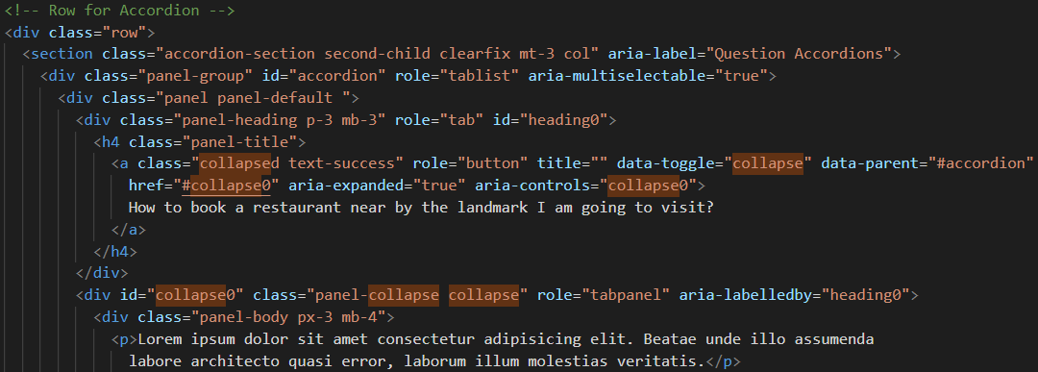
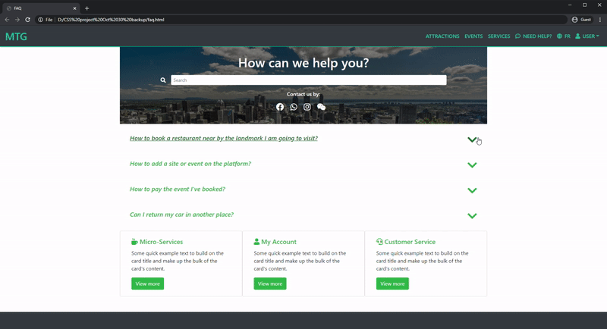
What I learned– FAQ page
Collapsible Accordion
Notes:
As a website provider, we tend to provide more useful information to the users. However, if we just simply put all the information on the page without proper setting, users can be overwhelmed by the information by end up with a terrible user experience.
And bootstrap accordion component is a nice way to balance the information we’re showing, it can provide a easy-to-use to show a summary of topics to user, if user is interested in certain topic, it can provide the detail content in a smooth way.

Slide 11
Future Works

Slide 12
Future Works
A page to link up tourists, residences and local service providers
U/X on mobile device
Javascript/Database related functions
Notes:
Our goal of this project is not limited to tourist attractions introduction website, in stead, we wanna provide a platform to link up tourists/residence and local service provider, provide accurate , timely and dynamic experience to all stakeholders. So people can discover the beauty of Montreal. So if we have more time, we will put more effort to build a dedicate page for this function.
Another things is , even though we applied BS to projects and pay a lot of attention on the responsive layout. We are not totally satisfied with the U/X in small screen mobile device. We’re eager to find a way to optimize this part .

